Slide 1

NIKE
MARKET EXPLORER
Unlocking Sales Dynamics for Strategic Growth

Slide 2

PROJECT OUTLINE
01
02
03
04
DATA PREPARATION
EXPLORATORY DATA ANALYSIS
REGIONAL ANALYSIS
CUSTOMER SEGMENTATION
05
PRICING AND PRODUCT ANALYSIS

Slide 3

01
DATA PREPARATION

Slide 4
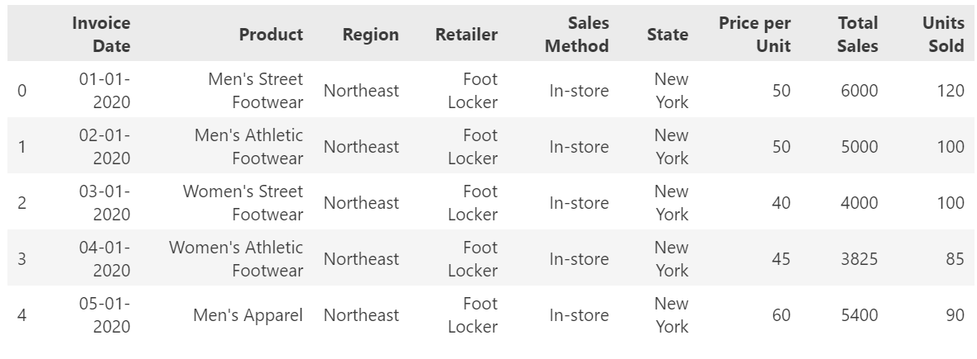
DATA PREPARATION

Slide 5
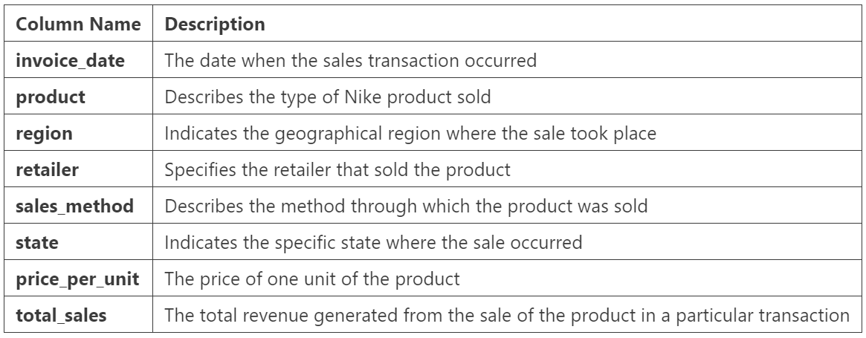
DATA PREPARATION
9 columns
9360 rows

Slide 6
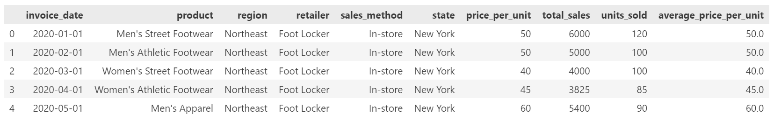
DATA PREPARATION

Slide 7
DATA PREPARATION
/ 6
/ 6
/ 3
Unique Products
Unique Retailers
Unique Sales Method
- Men's Street Footwear
- Men's Athletic Footwear
- Women's Street Footwear
- Women's Athletic Footwear
- Men's Apparel
- Women's Apparel
Foot Locker
Walmart
Sports Direct
West Gear
Kohl’s
Amazon
In-store
Outlet
Online

Slide 8
02
DATA
EXPLORATORY ANALYSIS
Sales Overview
Regional Performance
Product Category Analysis
Sales Method Analysis

Slide 9
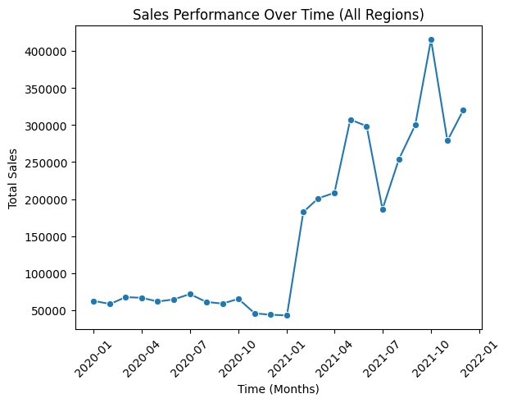
DATA EXPLORATORY ANALYSIS
Sale Overview
Notes:
Insights
Stable 2020: Sales remained steady throughout 2020 but dropped sharply toward the end.
Growth in 2021: Early 2021 shows a sharp rise in sales, likely due to successful campaigns or product launches.
Fluctuations: Mid-2021 shows peaks and troughs, indicating seasonality or market shifts.
Strong Finish: Late 2021 sees high, stable sales, suggesting improved customer retention or effective strategies.
Recommendations
Address Declines: Investigate and mitigate the late-2020 dip with off-season strategies.
Leverage Growth: Replicate early-2021 strategies for sustained momentum.
Plan for Fluctuations: Schedule promotions during expected troughs.
Maximize High Sales: Maintain late-2021 performance with loyalty programs and targeted campaigns.
Forecast & Optimize: Use trends to prepare resources for peak periods and improve low-demand phases.

Slide 10
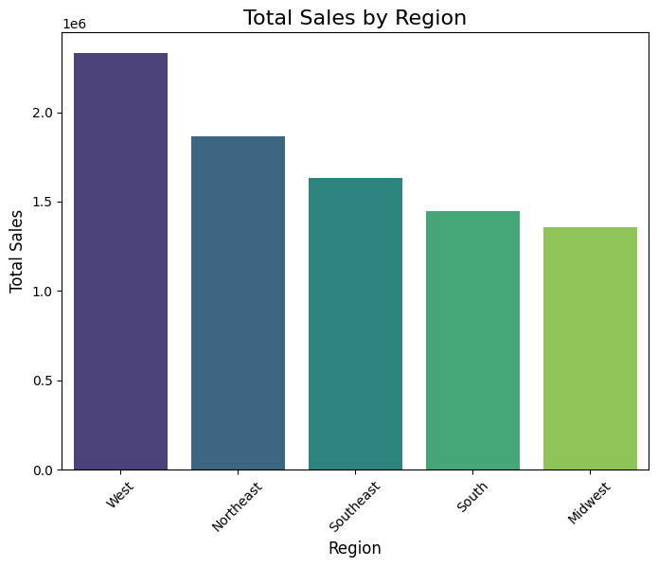
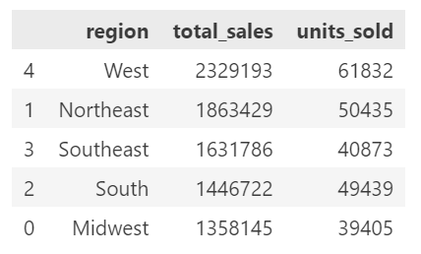
EXPLORE DATA
Sales Overview
Notes:
Insights
West Dominates: Highest sales (2.32M) and units sold (61,832).
Northeast Strong: Second-highest with 1.86M sales and 50,435 units sold.
Midwest Weak: Lowest performance (1.36M sales, 39,405 units sold).
Efficiency Gap: Southeast shows moderate units sold but lower revenue.
Recommendations
Focus on West: Increase investment to sustain growth.
Revive Midwest: Target promotions and research market gaps.
Improve Southeast Pricing: Adjust pricing to boost revenue.
Expand Northeast Reach: Strengthen inventory and campaigns.
Tailor by Region: Use localized strategies for customer needs.

Slide 11
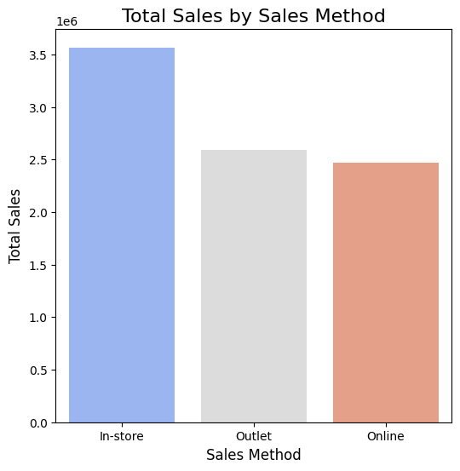
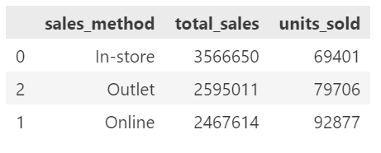
EXPLORE DATA
Sales Overview
Notes:
Highest Sales: In-store sales lead with the highest total sales ($3,566,650), despite having the lowest units sold (69,401). This suggests higher-priced items or higher-margin products.
Online: Online has the highest units sold (92,877) but the lowest total sales ($2,467,614), indicating lower-priced products or competitive pricing.
Outlet: Outlets perform in between for both metrics, balancing total sales ($2,595,011) and units sold (79,706).
Recommendations:
For In-Store: Focus on high-margin product promotion while improving customer volume to sustain profitability.
For Online: Consider upselling or bundling to increase average order value.
For Outlets: Assess product assortment to better optimize sales mix and pricing strategy.

Slide 12
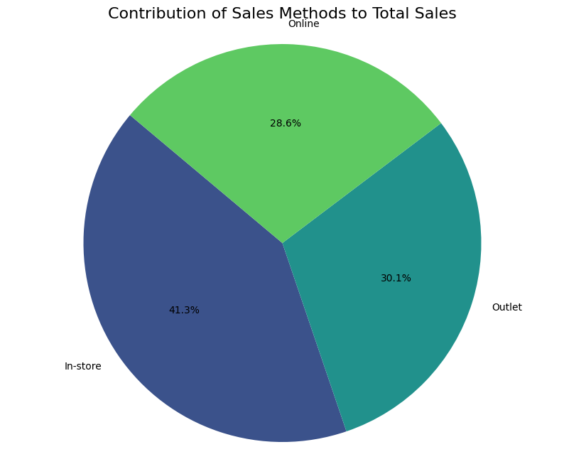
EXPLORE DATA
Sales Method Analysis

Slide 13
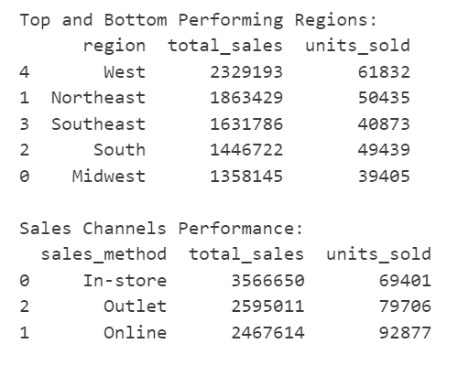
EXPLORE DATA
Sales Overview - Summary

Slide 14
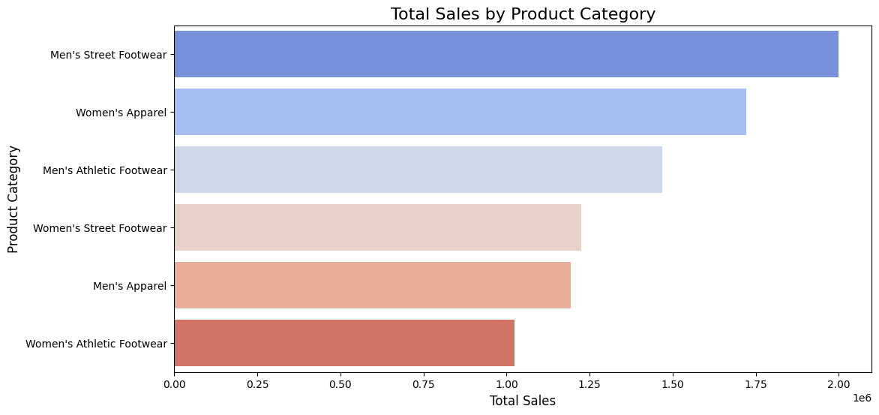
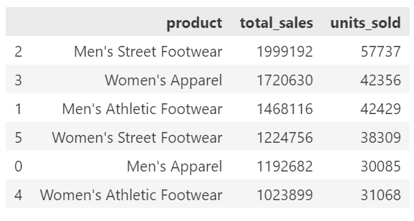
EXPLORE DATA
Product Category Analysis
Notes:
Top Product: Men's Street Footwear leads with the highest sales ($1,999,192) and units sold (57,737), indicating strong demand.
Women's Categories: Women's Apparel ($1,720,630) outperforms Women's Athletic Footwear in sales and units, suggesting a preference for casual items.
Low Performance: Men's Apparel and Women's Athletic Footwear show the lowest sales and units sold.
Recommendations:
Expand Popular Categories: Increase inventory and promotions for Men's Street Footwear and Women's Apparel to capitalize on demand.
Revamp Low Performers: Reevaluate pricing, marketing, or product design for Men's Apparel and Women's Athletic Footwear to improve sales.
Targeted Campaigns: Use data-driven marketing to highlight the strengths of underperforming categories.

Slide 15
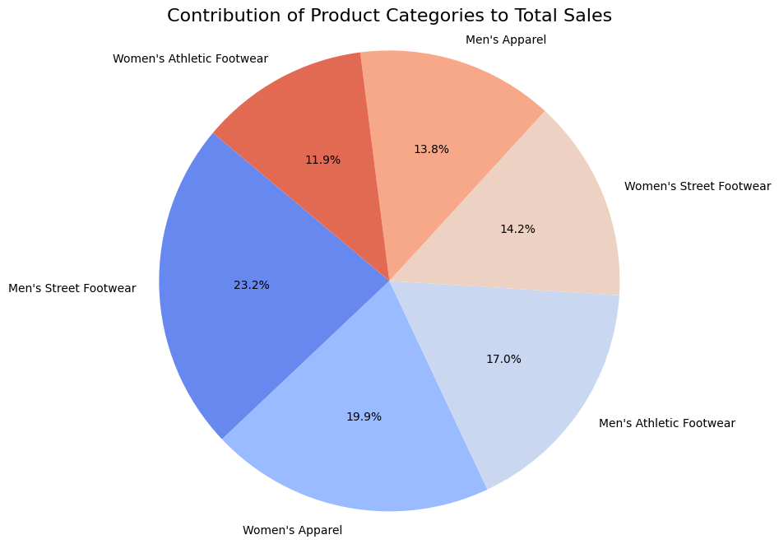
EXPLORE DATA
Product Category Analysis

Slide 16
03
REGIONAL
ANALYSIS
Sales Overtime
Top & Bottom Product Performance
Top & Bottom States Performance
Sales Method Performance

Slide 17
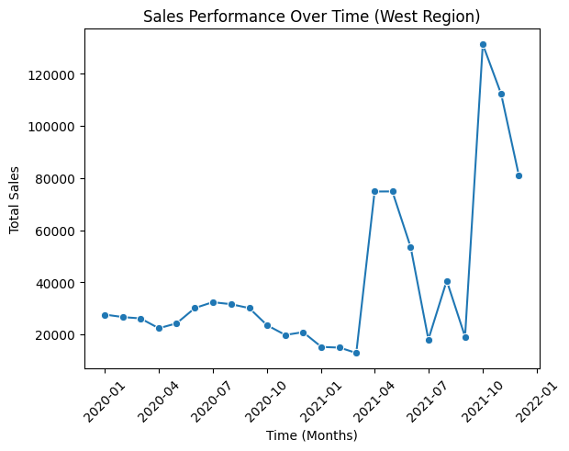
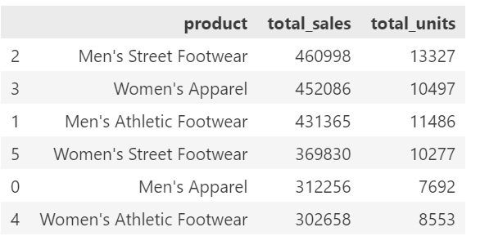
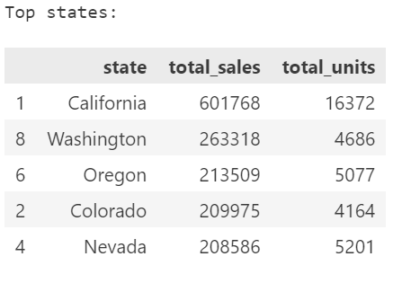
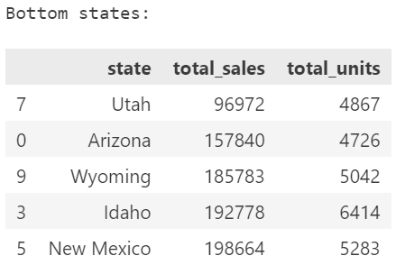
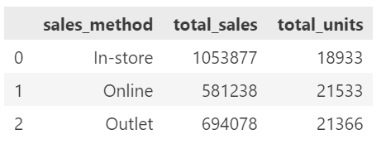
REGIONAL ANALYSIS
West
Notes:
Top Products: Men’s Street Footwear leads in total sales and units, followed by Women’s Apparel.
Sales Channels: In-store sales dominate, but online and outlets are close in unit sales.
Top States: California generates the highest sales, while Utah performs the lowest.
Trends: Sales peaked sharply in late 2021, with a notable volatility pattern (there was a sharp increase from 2021-01, and reached the peak in 2021-10, followed by a dramatical decrease.
Recommendations
Focus Products: Expand marketing for top-selling items (e.g., Men’s Footwear).
Channel Growth: Enhance online presence to compete with in-store sales.
Geographic Strategy: Boost sales efforts in weaker states like Utah and Arizona.
Sustain Peaks: Investigate and replicate drivers of late-2021 growth.

Slide 18
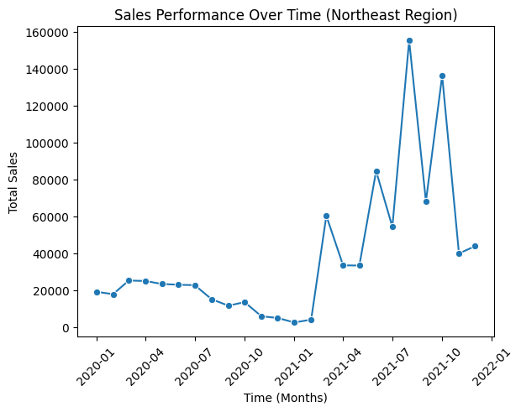
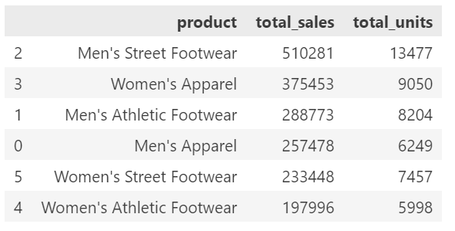
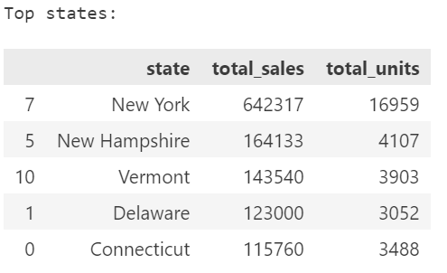
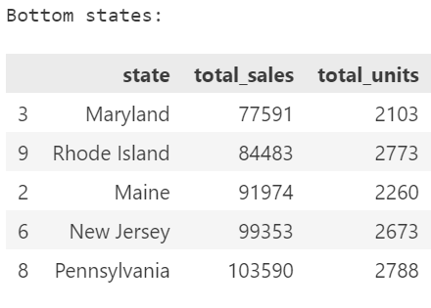
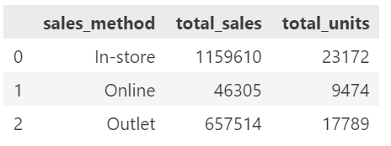
REGIONAL ANALYSIS
Northeast
Notes:
Insights
Top Products: Men’s Street Footwear leads sales, followed by Women’s Apparel.
Sales Channels: In-store dominates, but outlets contribute significantly.
Top State: New York generates the highest sales, while Maryland is the lowest.
Trends: Sales peaked in late 2021, with fluctuations afterward.
Recommendations
Focus on top products (e.g., Men’s Street Footwear) to drive growth.
Strengthen outlet sales and improve online presence to capture more market share.
Target low-performing states (e.g., Maryland, Rhode Island) with localized campaigns.
Analyze peak periods to sustain and replicate success.

Slide 19
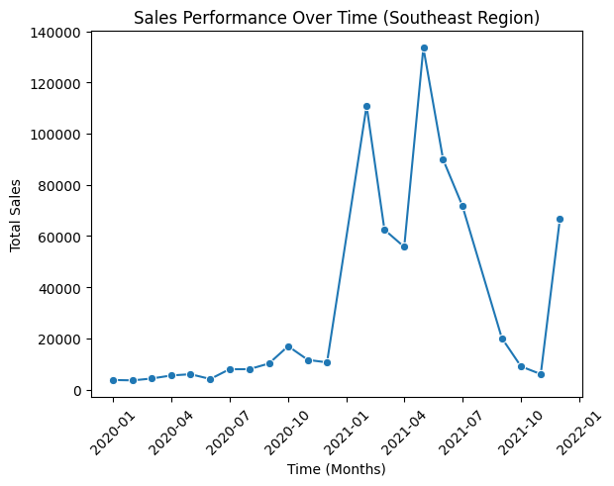
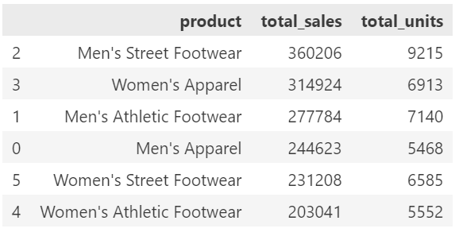
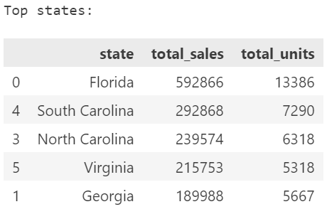
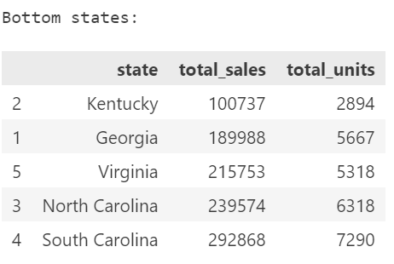
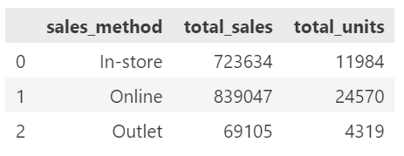
REGIONAL ANALYSIS
Southeast
Notes:
Key Insights:
Sales Trends: Peak sales occurred in early 2021, followed by a significant decline towards late 2021.
Top Products:
Men's Street Footwear leads in sales (360,206 units).
Women's Apparel follows closely (314,924 units).
Top States:
Florida is the best-performing state (592,866 total sales).
South Carolina and North Carolina also contribute significantly.
Bottom States: Kentucky and Georgia show the lowest sales, with opportunities for growth.
Sales Channels:
Online sales dominate (839,047 total sales).
In-store follows (723,634 total sales), while outlets are underperforming.
Recommendations:
Boost Declining Sales: Investigate reasons for the sharp drop in late 2021 and adjust strategies (e.g., promotions or seasonality planning).
Focus on High Performers: Invest in promoting top-performing products like Men's Street Footwear and target high-performing states like Florida to maximize returns.
Improve Underperforming States: Explore marketing campaigns or partnerships in Kentucky and Georgia to boost sales in these regions.
Enhance Online Presence: Since online sales lead significantly, continue to improve the online shopping experience with better offers, personalized recommendations, and faster delivery.
Evaluate Outlet Strategy: Assess the low performance of outlets and consider restructuring or consolidating underperforming locations.

Slide 20
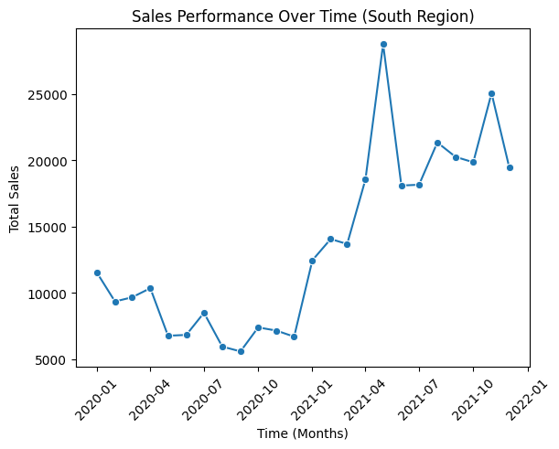
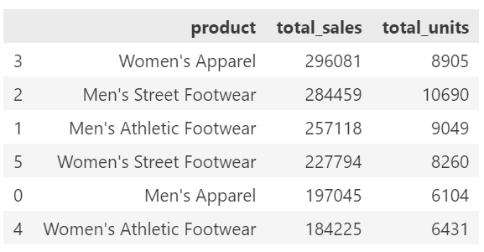
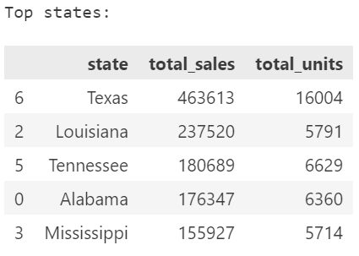
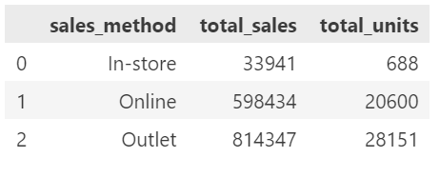
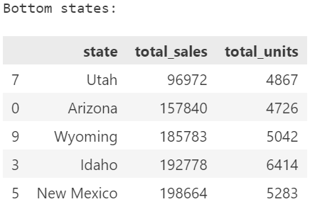
REGIONAL ANALYSIS
South
Notes:
Sales Trends: Gradual increase in sales, peaking in early 2021, with a stable upward trend afterward.
Top Products: Women's Apparel leads in sales (296,081 units), followed by Men's Street Footwear (284,459 units).
Top States: Texas dominates sales (463,613 total sales).
Louisiana and Tennessee follow as strong performers.
Bottom States: Utah and Arizona underperform, with minimal sales and units.
Sales Channels: Outlet sales are highest (814,347 total sales), outperforming both online and in-store sales.
Recommendations:
Capitalize on Top States: Increase marketing and stock availability in Texas and Louisiana to maximize potential.
Revitalize Low-Performing States: Run promotions or targeted campaigns in Utah and Arizona to improve visibility and sales.
Leverage Outlet Success: Expand the outlet network or introduce outlet-exclusive deals to sustain growth.
Diversify Product Promotion: Focus on boosting sales of lower-performing categories like Men's Apparel and Women's Athletic Footwear through tailored advertising.

Slide 21
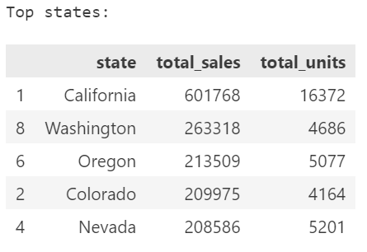
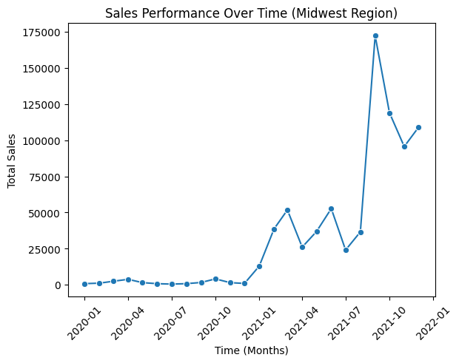
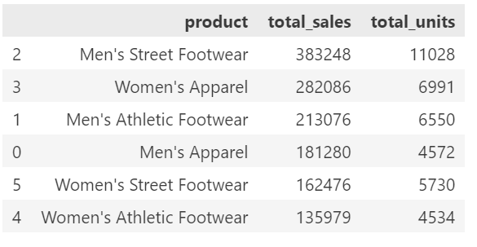
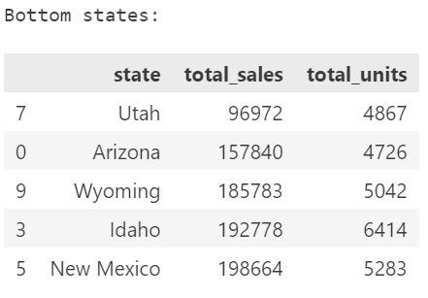
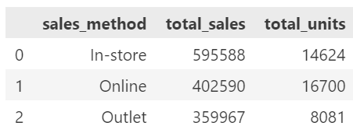
REGIONAL ANALYSIS
Midwest
Notes:
Sales Trends: Steady growth with a peak in mid-2021, followed by a moderate decline but stable performance.
Top Products: Men's Street Footwear dominates (383,248 total sales), followed by Women's Apparel (282,086 total sales).
Top States: California leads with 601,768 sales, followed by Washington and Oregon.
Bottom States: Utah and Arizona underperform in sales.
Sales Channels: In-store is the highest contributor (595,588 total sales), with online and outlets trailing behind.
Recommendations:
Maximize High Performers: Focus marketing efforts in California and other high-performing states.
Support Low-Performing States: Implement targeted campaigns in Utah and Arizona to boost visibility and sales.
Boost Online Sales: Despite being second, online sales have room for improvement; invest in user-friendly platforms and targeted promotions.
Focus on Product Trends: Enhance visibility for Men's Street Footwear and explore opportunities to grow sales for Women's Athletic Footwear, which has lower performance.

Slide 22
04
CUSTOMER
SEGMENTATION
Cluster Analysis
RFM Analysis

Slide 23
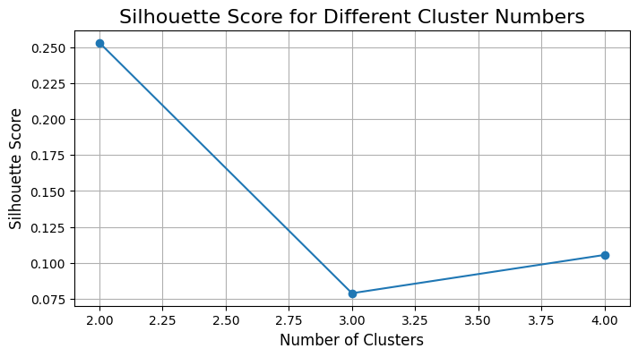
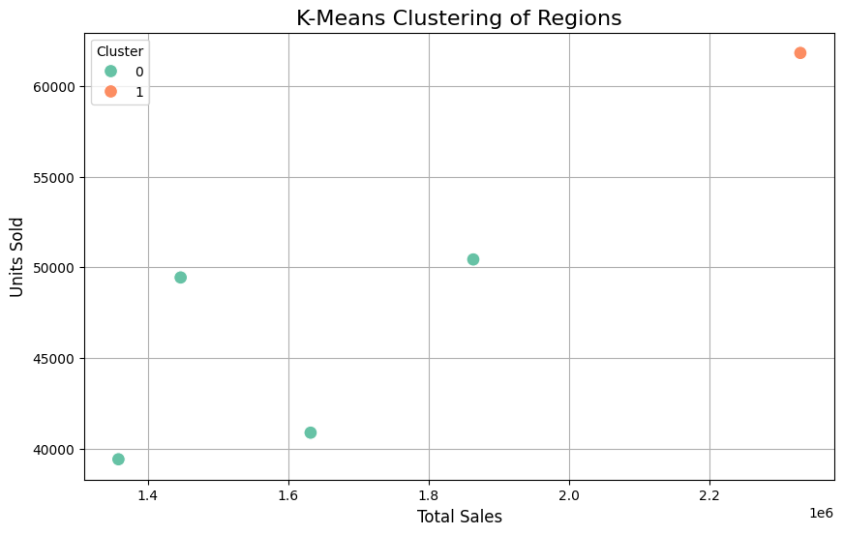
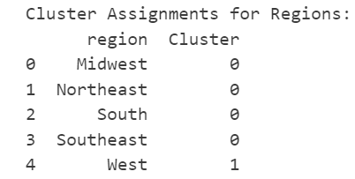
SEGMENTATION ANALYSIS
Cluster Analysis
Notes:
Insights:
Silhouette Score Analysis:
The highest silhouette score (0.25) at k=2 suggests that splitting the data into 2 clusters achieves the best separation and cohesion.
The score drops significantly at k=3, indicating weaker clustering quality.
K-Means Clustering (k=2):
Two distinct clusters are evident in the scatter plot:
Cluster 1: Regions with higher sales and units sold.
Cluster 0: Regions with lower sales and units sold.
Positive correlation between total sales and units sold across all clusters.
Recommendations:
Target High-Performance Regions (Cluster 1):
Focus marketing and resources on regions with high sales to maintain momentum.
Offer personalized promotions to sustain demand.
Improve Underperforming Regions (Cluster 0):
Investigate reasons for lower sales (e.g., product availability, pricing, or customer engagement).
Launch targeted campaigns or partnerships to boost performance.
Monitor Cluster Stability:
Regularly reevaluate the clustering as market dynamics change over time.

Slide 24
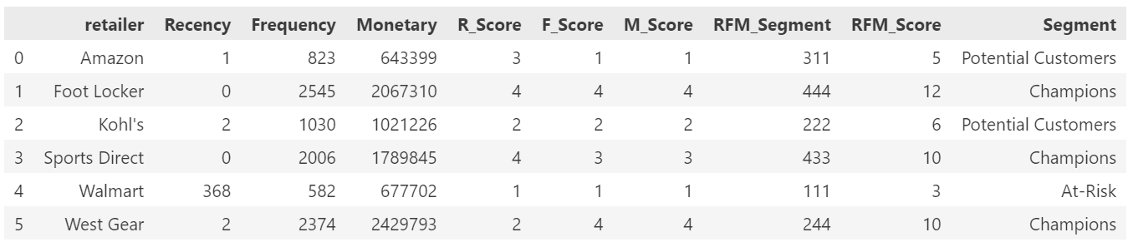
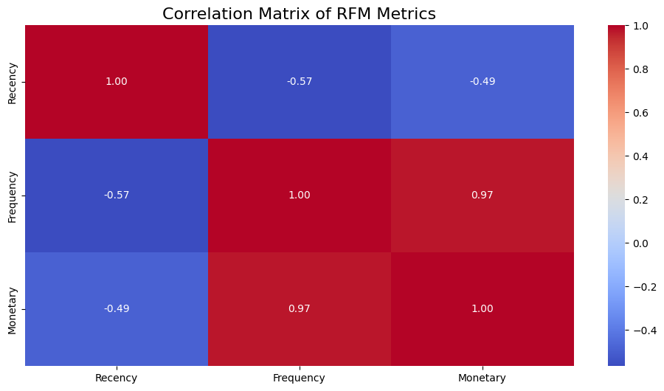
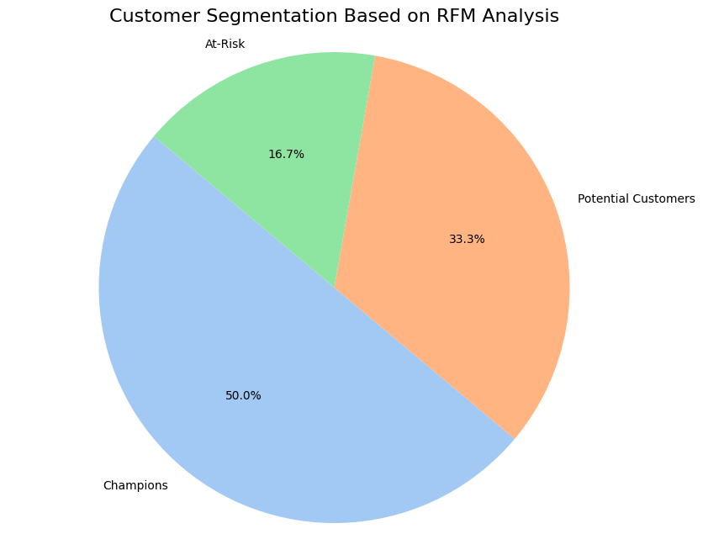
SEGMENTATION ANALYSIS
RFM Analysis
Notes:
Customer Segments:
Champions (50%): Loyal customers who frequently purchase and contribute significantly to revenue (Foot Locker, Sports Direct, West Gear)
Potential Customers (33.3%): Customers with moderate engagement; they have potential for higher value (Amazon, Kohl’s).
At-Risk (16.7%): Customers with low engagement and monetary contribution (Walmart).
Correlation Analysis:
Strong positive correlation between Frequency and Monetary (0.97): High purchase frequency aligns with higher spending.
Negative correlation between Recency and Frequency/Monetary: Recent interactions indicate higher customer value.
RFM Performance:
Foot Locker and West Gear are top-performing (Champions).
Walmart has the lowest RFM scores, indicating potential disengagement.
Recommendations:
For Champions:
Reward loyalty with exclusive offers, early access to sales, and personalized promotions to maintain engagement.
For Potential Customers:
Target with upselling campaigns, personalized recommendations, and limited-time discounts to move them toward the Champion segment.
For At-Risk Customers:
Use re-engagement strategies, such as win-back campaigns, surveys to understand disengagement, and offering incentives to reactivate them.
Overall Strategy:
Focus on improving customer experience by analyzing specific needs of each segment.
Leverage insights from the Frequency-Monetary correlation to drive high-value behaviors.

Slide 25
05
PRICING & PRODUCT
ANALYSIS
Pricing Impact
Product Performance
Pricing Strategy

Slide 26
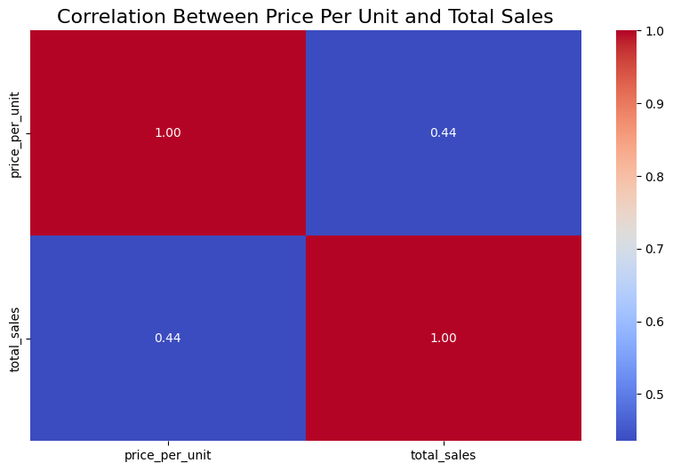
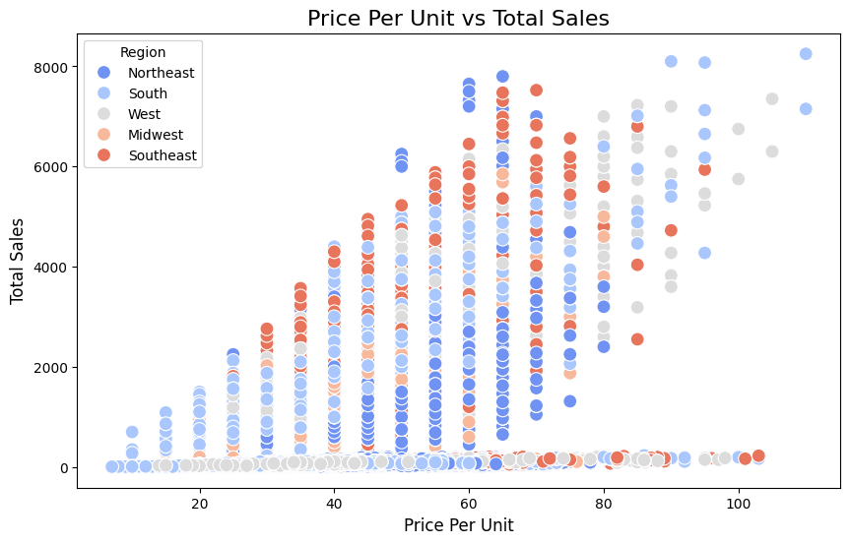
PRICING & PRODUCT ANALYSIS
Pricing Impact
Notes:
Insights:
Correlation Analysis:
Moderate positive correlation (0.44) between price per unit and total sales suggests higher prices lead to increased sales up to a point, indicating premium products might drive revenue.
Regional Trends:
Sales volumes vary across regions, with notable activity in the Southeast and West.
Higher price ranges see sales concentrated in specific regions, suggesting regional preferences for premium pricing.
Recommendations:
Optimize Pricing Strategy:
Experiment with tiered pricing to capture both budget-conscious and premium buyers.
Target regions like Southeast and West with premium products to maximize revenue.
Regional Marketing:
Tailor campaigns to emphasize value in regions with lower total sales.
Highlight premium offerings in regions showing stronger sales at higher price points.
----------------------
Sales Patterns Across Regions:
Southeast and West regions: These regions have a noticeable concentration of sales at higher price points, suggesting customers in these areas are more inclined to purchase premium-priced products.
Northeast and South regions: These show a broader spread across lower price points, indicating demand for mid-range or budget-friendly products.
Midwest: This region demonstrates moderate activity, with sales distributed across a wide price range but fewer outliers at the highest price points.
Density of Sales:
Higher total sales are clustered at mid-range prices ($20-$60 per unit) across most regions, suggesting a sweet spot for pricing products.
Sales drop off significantly at very high price points (> $80), but Southeast and West maintain some activity even in this range.
Market Preferences:
Regions like the Southeast appear to have a stronger demand for higher-priced products compared to regions like the South, which shows heavier sales in the lower price range.
------------------
For premium products, prioritize marketing and inventory allocation in regions like the Southeast and West.
For budget-friendly options, focus efforts on the Northeast and South, where demand for lower price points is stronger.
Conduct further research into regional customer preferences to fine-tune pricing and product offerings.

Slide 27
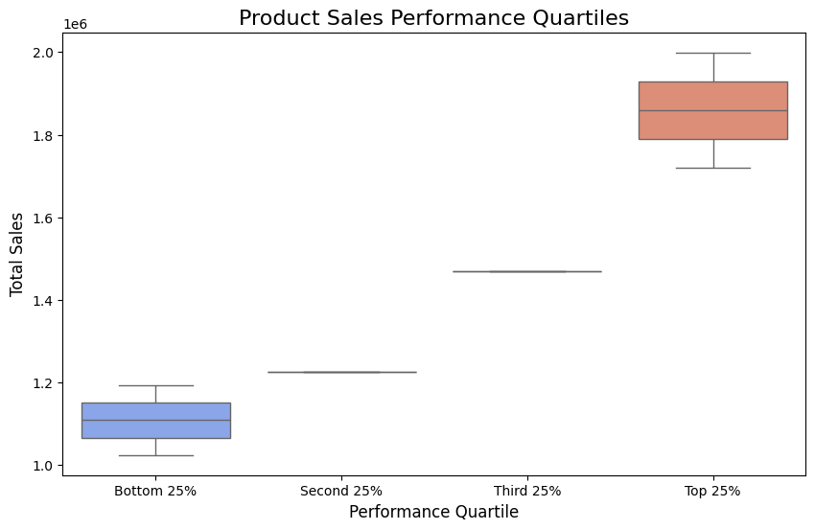
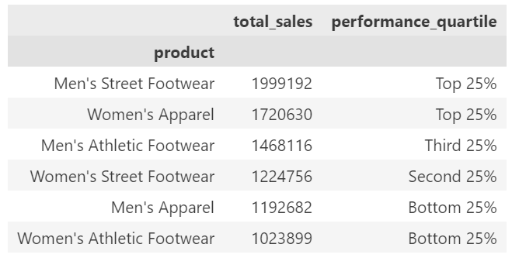
PRICING & PRODUCT ANALYSIS
Product Performance
Notes:
Quartile Representation:
Products are grouped into Bottom 25%, Second 25%, Third 25%, and Top 25% quartiles based on total sales.
Each box in the plot represents the range of sales for products within that quartile.
Insights from the Box Plot:
Top 25% Quartile:
The largest box, indicating a wide range of high-performing products, with total sales peaking around 2 million.
Includes products like Men's Street Footwear and Women's Apparel.
Second and Third Quartiles:
Moderate sales levels with narrower ranges, indicating stable but less competitive products like Women's Street Footwear and Men's Athletic Footwear.
Bottom 25% Quartile:
Small range of sales, with total sales not exceeding 1.2 million.
Represents underperforming products like Men's Apparel and Women's Athletic Footwear.
Outliers:
The lack of extreme outliers indicates that sales are relatively consistent within each quartile.
Products in the Top 25% drive the majority of total sales, making them crucial to overall performance.The Bottom 25% products have limited sales, suggesting the need for strategic adjustments.

Slide 28
PRICING & PRODUCT ANALYSIS
Pricing Strategy
1. Price-Sensitive Market (Bottom 25% performers):
Discount strategy: Apply discounts to make these products more appealing to customers. This can involve temporary price cuts or promotional offers like BOGO (Buy One Get One) or limited-time discounts
Phase-Out Strategy: If these products consistently perform poorly, consider discontinuing or replacing them with better-performing items
2. Premium Market (Top 25% performers):
- Premium Pricing: Since these products are doing well, we can experiment with slight price increases (if the market allows without losing customers).
Inventory Expansion: Increase the availability of these products in high-performing regions to meet demand
Exclusive Offers: Create exclusive bundles with accessories or related items to add value and increase perceived product quality

Slide 29
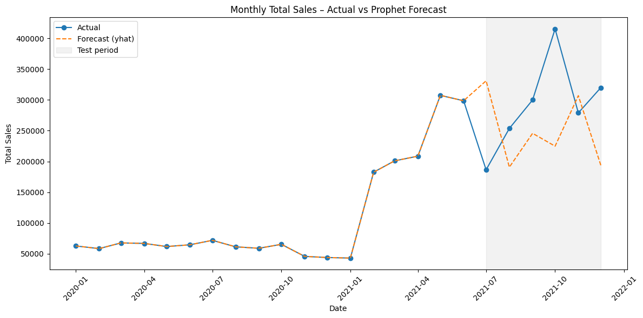
FORECASTING
Prophet Forecast
Notes:
The model performs well for baseline forecasting.
Underestimation in the test period suggests sales variability driven by external factors not included in the model.
Future improvements could include adding:
- holiday/seasonality regressors
- region-level models
- product-category segmentation
- price or marketing features.

Slide 30
SUMMARY
Regional and product sales show significant variance.
Distinct customer clusters highlight diverse buying behaviors.
What Nike needs to do:
Boost Premium Product Focus: Expand inventory and introduce value-added bundles
Revive Low Performers: Apply targeted discounts or phase out poor sellers.
Regional Focus: Prioritize investment in high-performing regions.

Slide 31

Thank you!

